Slide 1
UE18CS390A – Capstone Project Review #3
(High Level Design and Proposed Methodology)
Project Title : Smart Classroom Solutions
Project ID : 71
Project Guide : Dr. Annapurna
Project Team : Akshaya Visvanathan (PES2201800089)
Bhavan Naik (PES2201800047)
Akhil S Kumar (PES2201800137)
Atharva Moghe (PES2201800131)

Slide 2
Outline
Abstract
Summary of Literature Survey
Suggestions from Review – 2
Proposed Methodology / Design Approach
Architecture
Design Description
Technologies Used
Project Progress
References

Slide 3
Abstract
Problem Statement:
A proposal for an IoT-based intelligent environment, with the primary objective of energy optimization and an intelligent, yet reliable attendance system that focuses on reducing latency to give an enhanced learning experience.

Slide 4
Summary of Literature Survey in Review 2
The use of Internet of Things in the advanced world is the focal point of enthusiasm of numerous analysts and standardization bodies since quite a long while. The project will introduce the total adaptation of approaches of an intelligent classroom framework. We will likewise introduce a composition of the proposed model.
As a conclusion of extensive literature survey, we have curated the following results:
In general, campuses spread over a fairly-large area and it is very difficult for management to track everything that happens. This forms a highly interconnected network that operates over a Mobile Crowd Sensing network and generates an immense volume of data.

Slide 5
Summary of Literature Survey in Review 2
Attendance information has always been an important part of university management. However, some opportunistic students may consign others to punch their timecards, which hampers the authenticity of attendance and effectiveness of record keeping.
Most of colleges and universities use the traditional lighting system where we have a switch to control the lighting. Most of us i.e., students and faculty members are habituated towards leaving the classroom without switching the lights and fans, which leads to unnecessary consumption of energy for organization and paying huge amount of bill from their budget.
The system developed will control lighting in particular area of classroom based on the presence of human using relay control compared to the one placed in ceiling which would switch on or off based on presence of human in room irrespective of position.

Slide 6
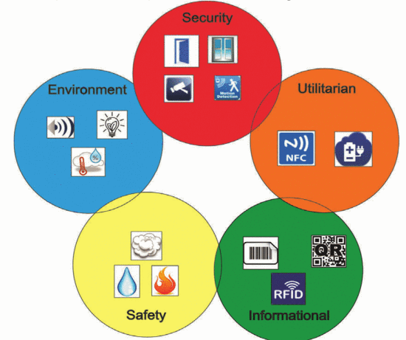
Summary of Literature Survey in Review 2
- Type of Sensors that Can Be Used in a Smart University:
Sensors and technologies can be identified
depending on their usefulness in a university
campus; then they can be used
and after that split in the following categories:

Slide 7
Suggestions from Review – 2
Provide the suggestions and remarks given by the Guide:
Extension of Project to Smart Campus.
Type of ML/AI analysis used for the Project.
Add Humanitarian side to the Project.
Mention the feasibility on the same showing the progress:
We have plans to extend it but it all depends upon the time available.
Any Multi-class ML Analysis.
Extra food distribution using Shortest-Path Algorithm.

Slide 8
Design Details
Novelty/ Uniqueness of the Project:
Automated yet reliable attendance system that would help improve classroom learning. Fool proof solution is important keeping in mind the innovative ways students find to bypass attendance systems.
Real-time implementation that is independent of the wiring system and hence may be extended to Government schools and colleges, in order to reduce their electricity costs.
Help reduce harmful effects of unsolicited energy consumption on the environment and save our planet for future generations.

Slide 9
Proposed Methodology / Approach -1
Attendance:
Attendance can be taken electronically by means of a biometric optical fingerprint scanner.
Security and integrity can be ensured by making the biometric module portable and modular - a small phone sized module carried by the teachers.
The teacher can pass around/have each of the students scan their prints and register their attendance with no manual intervention.

Slide 10
Proposed Methodology / Approach -2
Electricity Optimization:
Spatial sensors placed at the edges of classrooms will notify the system of movement and activity in the room.
Edge computed algorithms ensure that the lights and fans are turned on only at specific portions of the room incase of a large classroom/hallway.
In case of manual fans, temperature monitors are used to add a level of cost-effective automation.

Slide 11
Architecture
Application Components:
Attendance Logging Component
Power Component
Temperature Modulation Component
Database Component

Slide 12
Architecture
Data Components:
Raw Fingerprint Data
Power Consumption Values
Current Room temperature
Database connectors

Slide 13
Architecture
User Groups:
Teachers
Students
Administrator

Slide 14
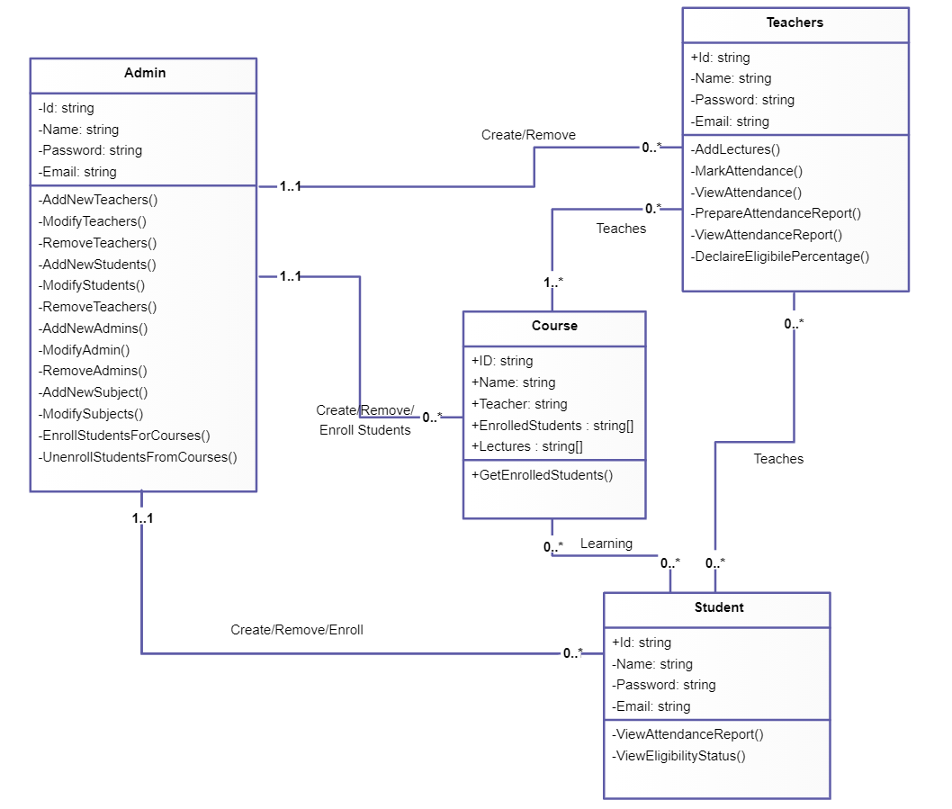
Design Description
Class Diagram:

Slide 15
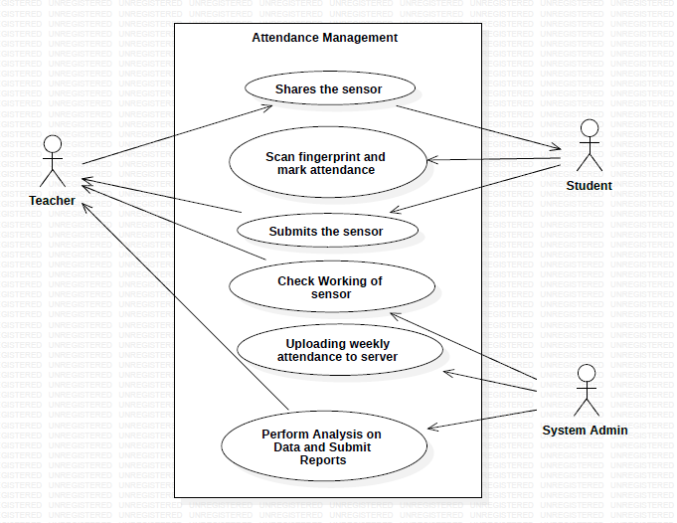
Design Description (if applicable)
Use-Case Diagram:

Slide 16
Technologies Used
Optical Biometric Sensor Module
Spatial sensors
Raspberry Pico Microcontroller
WPF/UWP

Slide 17
Project Progress
Progress so far:
Literature Survey
Architecture Proposal
Desired Changes
3 Reviews accompanying documentation
CapStone Phase-1 Report (in progress)
What is the percentage completion of the project?
- 25%

Slide 18
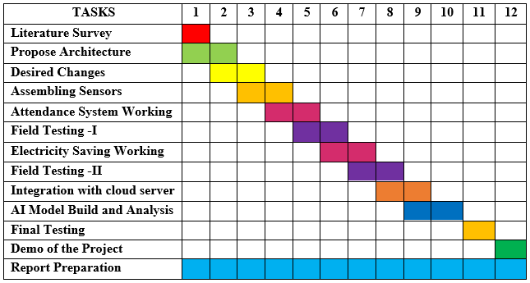
Capstone (Phase-I & Phase-II) Project Timeline

Slide 19
Conclusion
We are currently looking to add some more features and extend the project from classroom level to university level thereby renaming it to “Smart Campus System”.
We are also looking forward to add a Humanitarian Side to our project.
Looking at Feasible Algorithms for Analysis of data collected from the sensors.

Slide 20
References
https://ietresearch.onlinelibrary.wiley.com/doi/pdfdirect/10.1049/iet-net.2018.5182
https://iacis.org/iis/2018/3_iis_2018_33-41.pdf
https://ieeexplore.ieee.org/abstract/document/8553750
https://ieeexplore.ieee.org/abstract/document/9086010
https://link.springer.com/article/10.1007/s10462-018-9648-9
https://ieeexplore.ieee.org/document/8871173
https://ieeexplore.ieee.org/document/6907930
https://ieeexplore.ieee.org/document/8767229
https://ieeexplore.ieee.org/document/8519856

Slide 21
Thank You

